Slide 1
HIGH LEVEL DESIGN
High-Level Design (HLD) provides a macro view of the system. It outlines the architecture, subsystems, modules, and how they interact. Unlike Low-Level Design, which deals with specific implementations, HLD focuses on−
The system's major components.
Communication protocols between components.
Scalability and performance considerations.
HLD often represents the "what" of a system, while LLD answers the "how."
Goals of High-Level Design
Clarity− Provide a clear and shared understanding of the system's architecture.
Direction− Guide developers by offering an architectural roadmap.
Scalability− Anticipate future growth and design for it.
Alignment− Ensure that technical decisions align with business objectives.
High-level design is an initial step in the development of applications where the overall structure of a system is planned. High-level design focuses mainly on how different components of the system work together without getting to know about internal coding and implementation.

Slide 2
Key Components of High-Level Design
A well-defined High-Level Design typically includes−
System Architecture
This defines the overall structure, including−
Architectural pattern− Monolithic, Microservices, Event-driven, or Serverless.
Core layers− Presentation layer, business logic layer, and data layer.
Deployment model− On-premises, cloud, or hybrid.
Subsystems and Modules
HLD breaks down the system into logical subsystems or modules. For example−
E-commerce system− Modules like User Management, Order Management, and Inventory.
Data Flow
Describes how data flows across components and external systems. This includes−
Input/Output specifications.
Communication protocols (e.g., HTTP, gRPC).
External integrations (e.g., APIs, message queues).

Slide 3
Database Design
Defines high-level database structures, such as−
Choice of databases− Relational (MySQL) or NoSQL (MongoDB).
Partitioning and sharding strategies for scalability.
Non-Functional Requirements (NFRs)
Addresses aspects like−
Scalability− Handle increasing load efficiently.
Availability− Minimize downtime (e.g., 99.99% uptime).
Security− Protect sensitive data.
Performance− Optimize for latency and throughput.
Interfaces and APIs
Defines interaction points between internal and external systems. For example−
RESTful APIs or GraphQL endpoints.
Data formats like JSON or XML.

Slide 4
Principles of High-Level Design
High-Level Design must adhere to key principles to ensure a robust system−
Modularity− Divide the system into independent, loosely coupled modules to improve maintainability.
Scalability− Design to handle future growth in users, traffic, or data.
Performance− Optimize response times and minimize resource usage.
Security− Ensure components are protected from potential vulnerabilities.
Reusability− Design modules that can be reused across multiple projects.
Reliability and Fault Tolerance− Create fail-safe mechanisms to handle errors or outages gracefully.
Simplicity− Avoid over-engineering; keep the design easy to understand and implement.

Slide 5
The Process of High-Level Design
Creating a High-Level Design involves several steps−
Gather Requirements
Collect functional and non-functional requirements from stakeholders. For example−
Functional− User authentication, product recommendations.
Non-functional− 99.99% uptime, 200ms response time.
Choose an Architecture
Decide on an architectural pattern that best suits the requirements−
Monolithic− Suitable for small, simple systems.
Microservices− Ideal for scalability and modularity.
Event-Driven− For real-time applications like IoT.
Serverless− For event-based, cost-efficient systems.
Define Major Components
Identify and define the system's major components, such as−
Application servers.
Databases.
Load balancers.
Specify Data Flow
Map how data travels between components and external systems.
Document and Visualize
Use diagrams to represent the system design, such as−
UML diagrams (Class, Sequence, and Deployment diagrams).
Data flow diagrams.
Component diagrams.

Slide 6
Tools and Techniques for High-Level Design
Tools
Lucidchart− Ideal for flowcharts and architecture diagrams.
Draw.io− Free tool for creating component and data flow diagrams.
Microsoft Visio− Professional diagramming software.
Enterprise Architect− Advanced tool for UML and system modelling.
Techniques
Unified Modelling Language (UML)− Standardized visual representations.
Data Flow Modelling− Illustrate how data moves within the system.
Component-Based Design− Focus on defining reusable components.

Slide 7
Examples of High-Level Design
Example 1: E-Commerce Platform
Components−
Presentation Layer− Angular-based frontend.
Backend Services− Microservices using Spring Boot.
Database− Relational database for transactions, NoSQL for caching.
Load Balancer− Ensures high availability.
Data Flow−
User requests → API Gateway → Microservices → Database → Response.
Example 2: Video Streaming Service
Components−
Content Delivery− CDN for streaming content.
Recommendation Engine− Machine Learning-based personalization.
Authentication Service− OAuth2 for secure login.
Data Flow−
Video request → CDN → Backend services → Database → Response.

Slide 8
The goal of HLD is to provide a detailed overview of the system's structure, components, and interactions, setting the direction for the detailed design and implementation phases of the project. HLD is a crucial phase in the software development lifecycle, where the overall architecture and design of a system are outlined broadly and comprehensively.
1. System Understanding
The primary goal of HLD is to ensure that stakeholders, including developers, architects, and project managers, have a clear understanding of the overall system architecture and design. This includes understanding the major components of the system, how they interact with each other, and the overall flow of data and control within the system.
2. Component Identification
HLD aims to identify the major components or modules of the system and define their roles and responsibilities. This helps in organizing the system into manageable parts, making it easier to design, implement, and maintain.
3. Interface Specification
HLD defines the interfaces between the different components of the system. This includes specifying the data that is exchanged between components, the protocols used for communication, and any other requirements for interaction between components.
4. Technology Selection
HLD outlines the technologies, frameworks, and tools that will be used to implement the system. This includes decisions about programming languages, databases, middleware, and other software and hardware components.

Slide 9
5. Scalability and Performance
HLD considers the scalability and performance requirements of the system. This includes identifying potential bottlenecks and performance issues and outlining high-level strategies for addressing these issues, such as using caching, load balancing, or database optimization techniques.
6. Risk Mitigation
HLD identifies potential risks and challenges in the design and implementation of the system. This includes risks related to technology, resources, schedule, and other factors. HLD outlines strategies for mitigating these risks, such as using proven technologies, conducting thorough testing, and having contingency plans in place.
7. Alignment with Requirements
Finally, HLD ensures that the system design aligns with the requirements and objectives of the project. This includes ensuring that the design meets functional and non-functional requirements, such as usability, security, and compliance requirements.

Slide 10
Common Challenges in High-Level Design
Requirement Ambiguity− Incomplete or vague requirements can lead to incorrect designs.
Scalability Trade-offs− Balancing scalability with cost and complexity.
Integration Complexity− Ensuring seamless communication between heterogeneous systems.
Over-Engineering− Avoiding unnecessary complexity in the design.
Evolving Requirements− Adapting the design to accommodate changes in requirements.

Slide 11
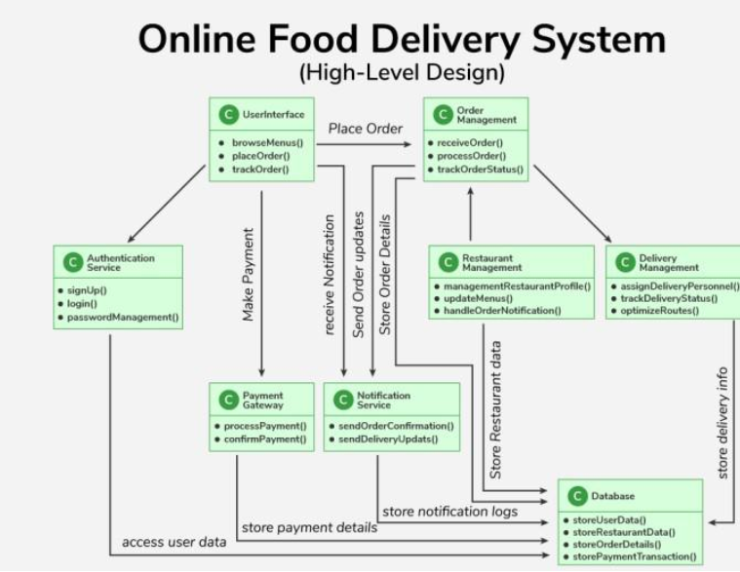
EXAMPLE OF HIGH LEVEL DESIGN

Slide 12
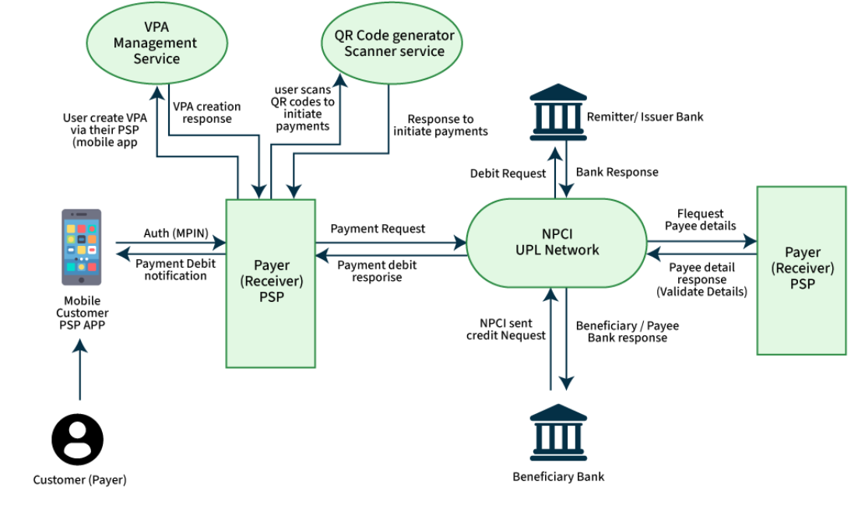
UPI DESIGNING// Bank

Slide 13
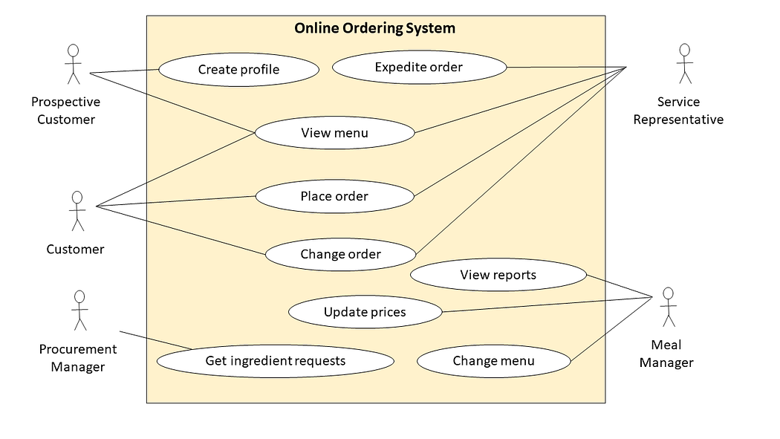

Slide 14
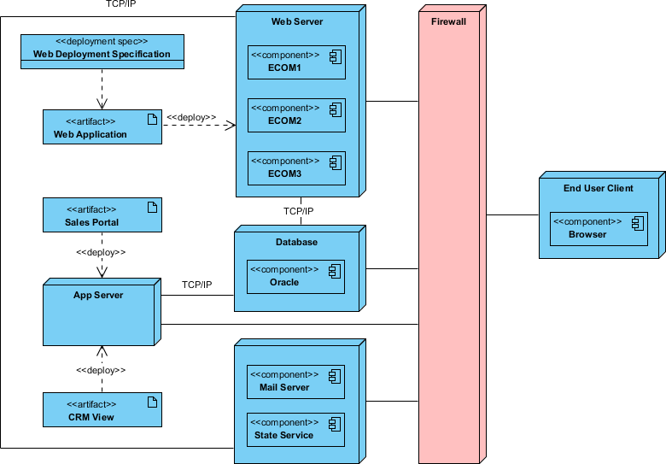

Slide 15
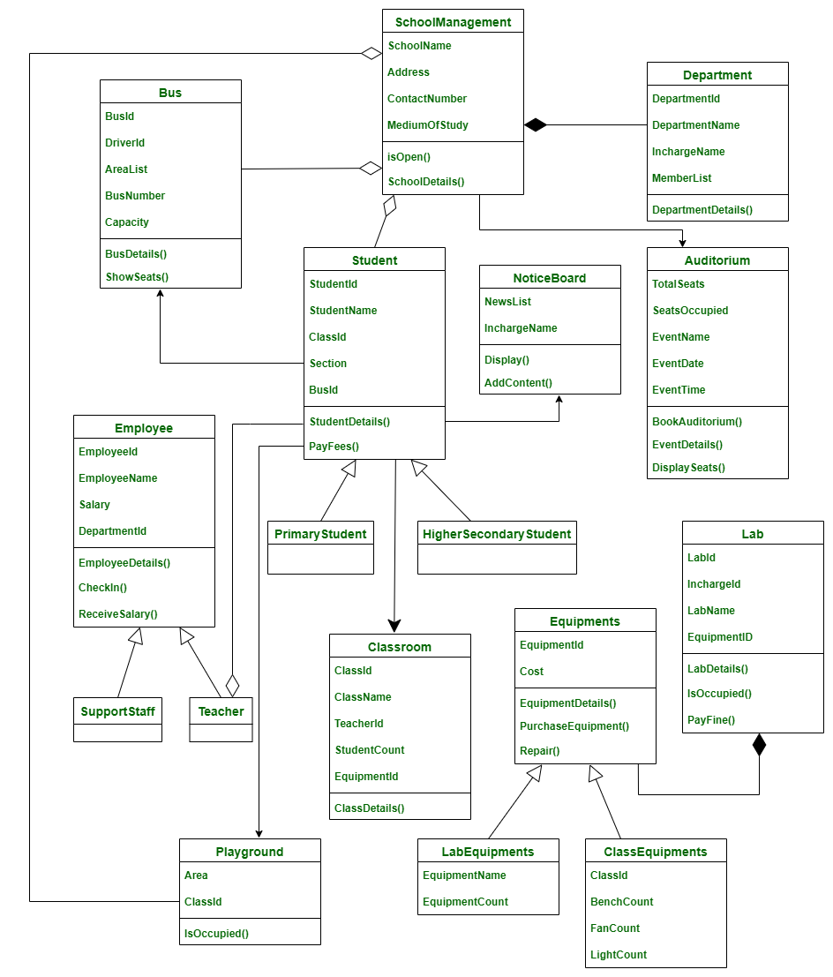
SCHOOL MANAGEMENT SYSTEM- LOW LEVEL DESIGN

